Slide 1


Virtual Computer Mouse using mmWave Radar (TI):
Oscar Chavez Araiza
Greyson Heath
Daniel Lu
Zane Meikle
ECEN 403

Slide 2
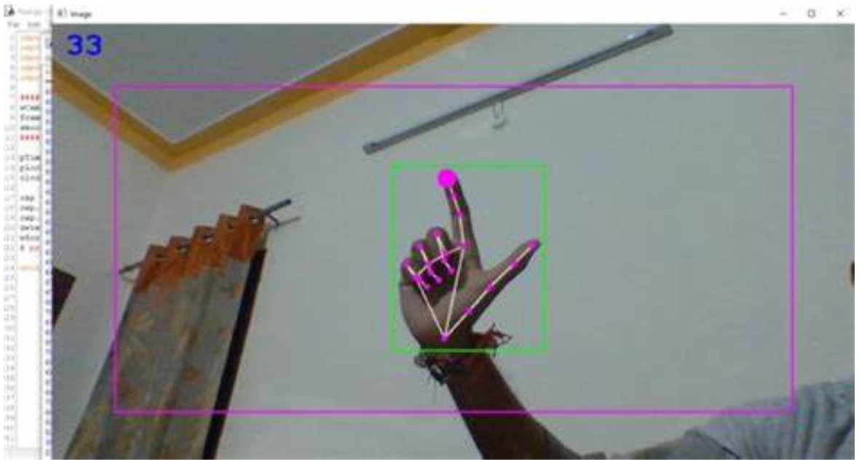
Project Description:
Problem statement:
Virtual mice today are traditionally done using computer vision and a camera (as seen on the right).
But these systems are processing and power intensive.
Solution proposal:
Create a virtual mouse using a Texas Instruments (TI) mmWave Radar and a ML model to make a less power and processing intensive virtual mouse.

Slide 3
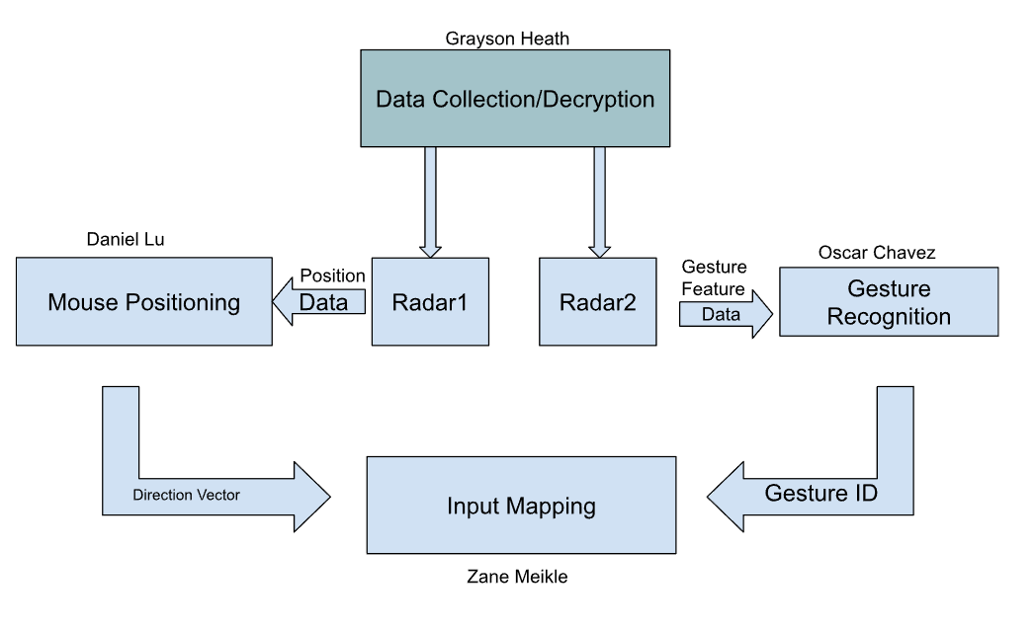
System Overview

Slide 4
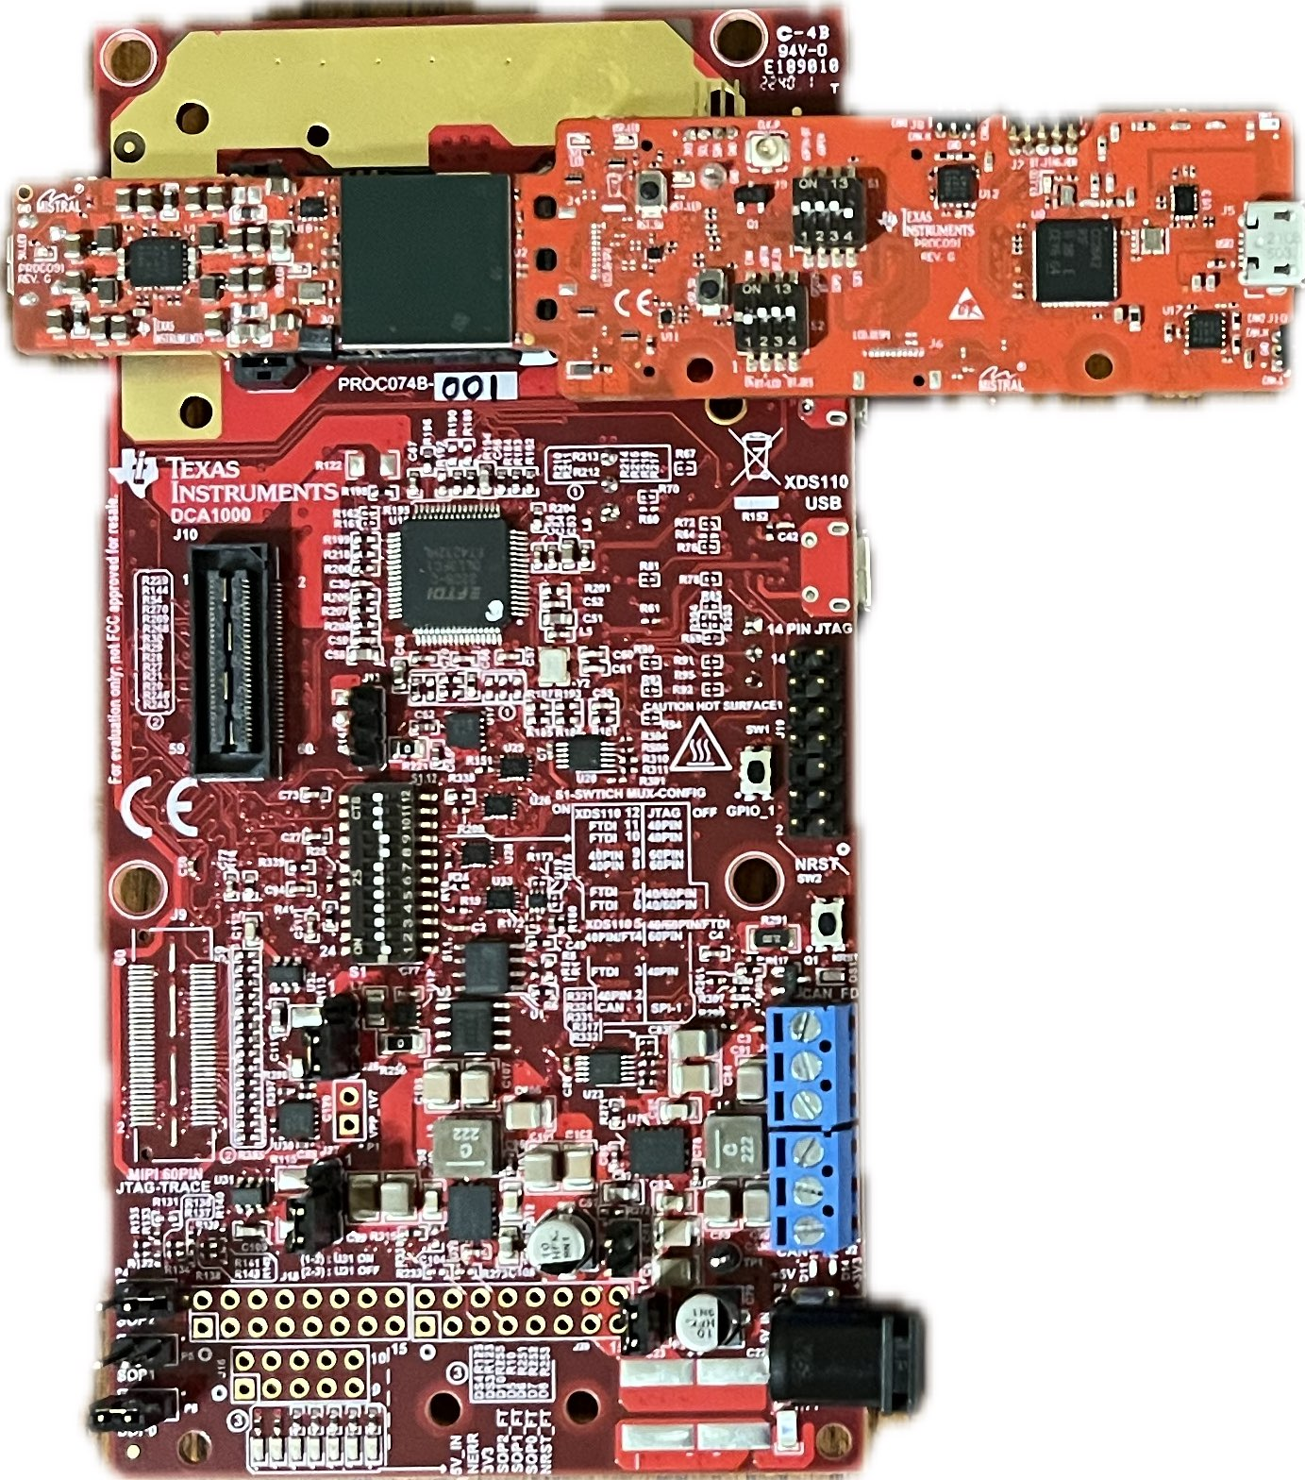
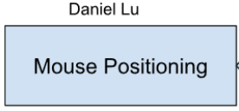
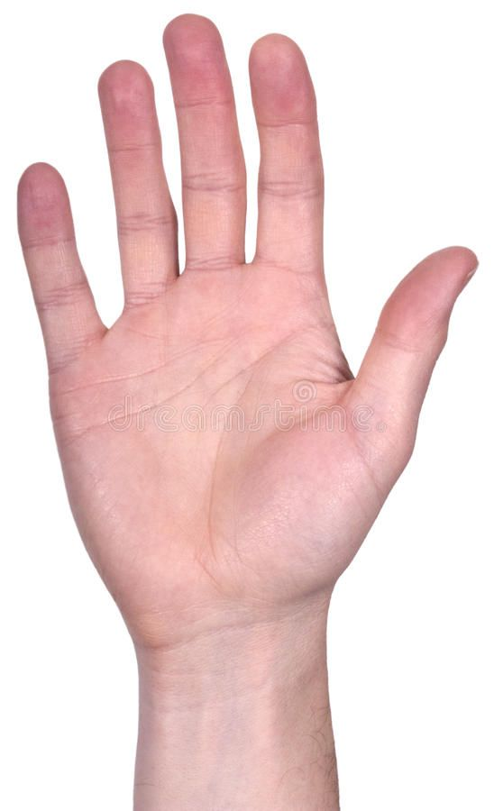


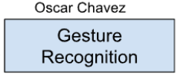
Radar Config / Data Collection
Front end of our system
Both radars flashed with TI binary files
Out-of-Box (Mouse Position)
Gesture ML (Mouse Action)
Collected and decoded respective data
(2x) IWR6843AOPEVM
(2x) MMWAVEICBOOST
Data Parser
Notes:
So my subsystem involves the front end of our system, and I work directly with the radar devices and their communication with the computer.
Initially, a lot of time was spent troubleshooting the devices. There was a lot of back and forth with our sponsor, Nick, and he was extremely helpful at providing solutions and resources.
After the radars were up and running, we decided as a team to run both radars in parallel, both being flashed with respective programs.
One radar is flashed with the TI out-of-box binary that will represent the mouse position
THe other radar is flashed with a TI Gesture ML Binary that will represent the mouse actions

Slide 5
Hand Tracking on Pointer Radar
Notes:
Here’s an example of 3D scatter plot on the TI visualizer. Here, I am spinning my hand in front of the radar in clockwise and counterclockwise circles, and side to side. I apologize for the poor viewing conditions, for some reason the plot range was 10 meters in X Y and Z, and we are working at about a foot and a half in front of the radar, so its a bit squished.

Slide 6
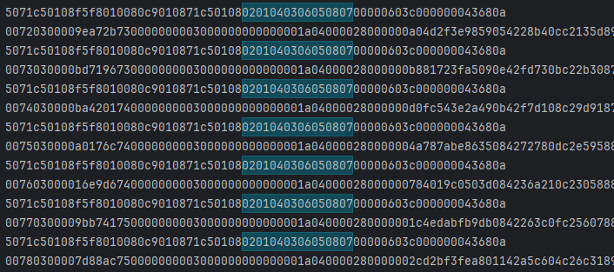
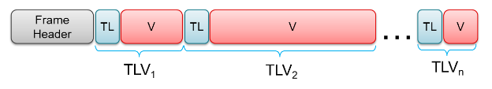
Raw UART Data Output
…
…
…
…
…
…
…
Notes:
This is an example of the raw UART data output from the devices. They use a TLV, type-length-value encoding scheme, and per frame, a packet is sent which always consists of a 40-byte frame header and a variable number of TLV’s depending
-Radar outputs data using a type-length-value encoding scheme. Per frame (single set of data), a packet is sent which always consists of a 40-byte frame header, and a variable number of TLV’s depending on what was detected. Within the TLV’s exists data such as X, Y, Z, doppler, range, number of points, and elevation.

Slide 7
Terminal Output
Mouse Positioning Data
Gesture Data
Pointer Data
[# Points] | [Frame #]
Point 1: [X, Y, Z]
Point 2: [X, Y, Z]
…
Gesture Data
[Frame #]
Features: [size 10]
…
Notes:
Pointer Data: X, Y, Z, doppler, SNR, noise
Gesture Data: Weighted doppler, range, elevationMean, AzimuthMean

Slide 8
Gesture Recognition Work so Far
Choose two low x-y motion gestures to minimize interference with hand tracking.
Used the same features as TI’s model to train our CNN model (~97% accurate).
Our approach used 40 frame snippets to train the model (~1.4 seconds).
The current model was trained at a max range of ~1½ ft.

Slide 9
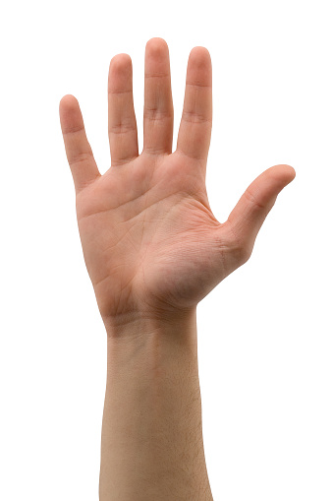
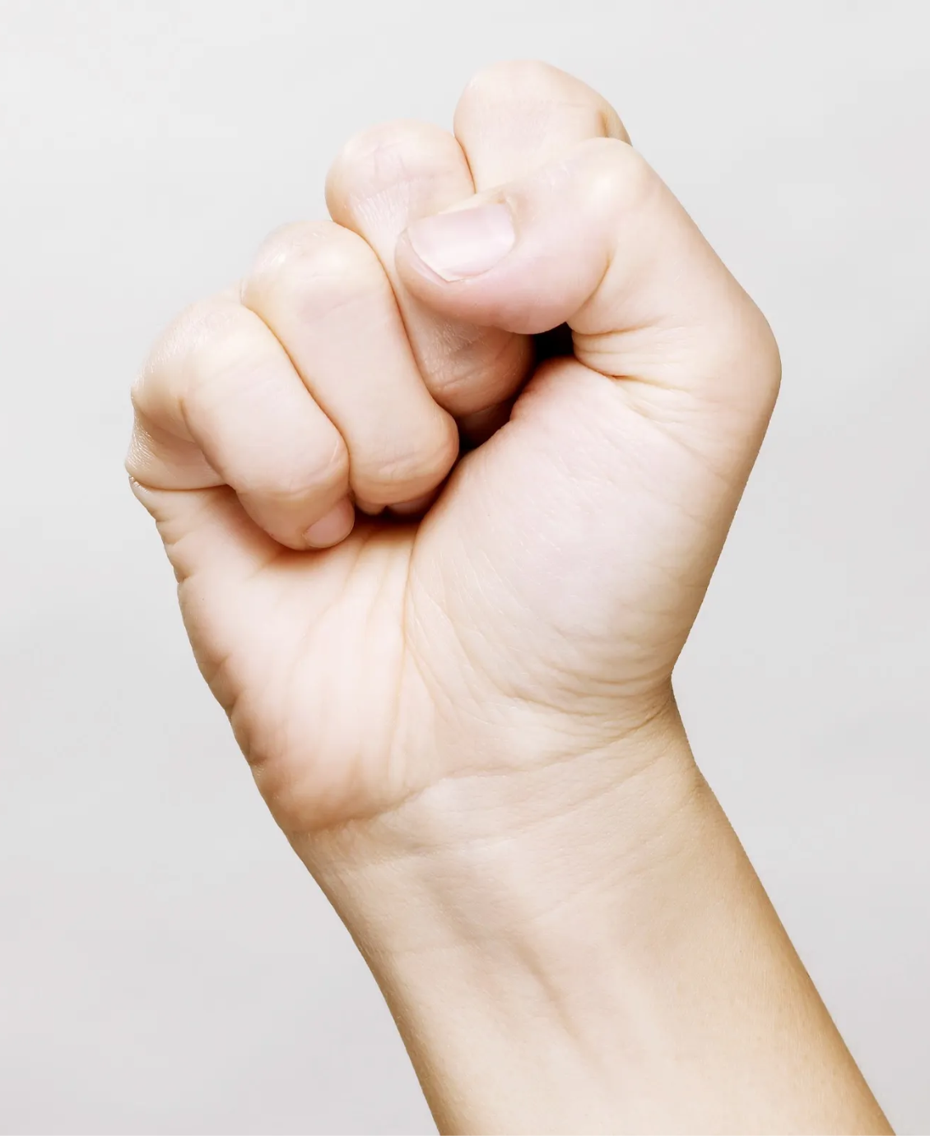
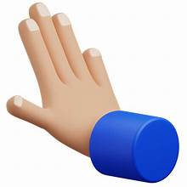

Gestures
Gesture [1] (L-Clk)
Shine Gesture
Gesture [2] (R-Clk)
Push Gesture

Slide 10
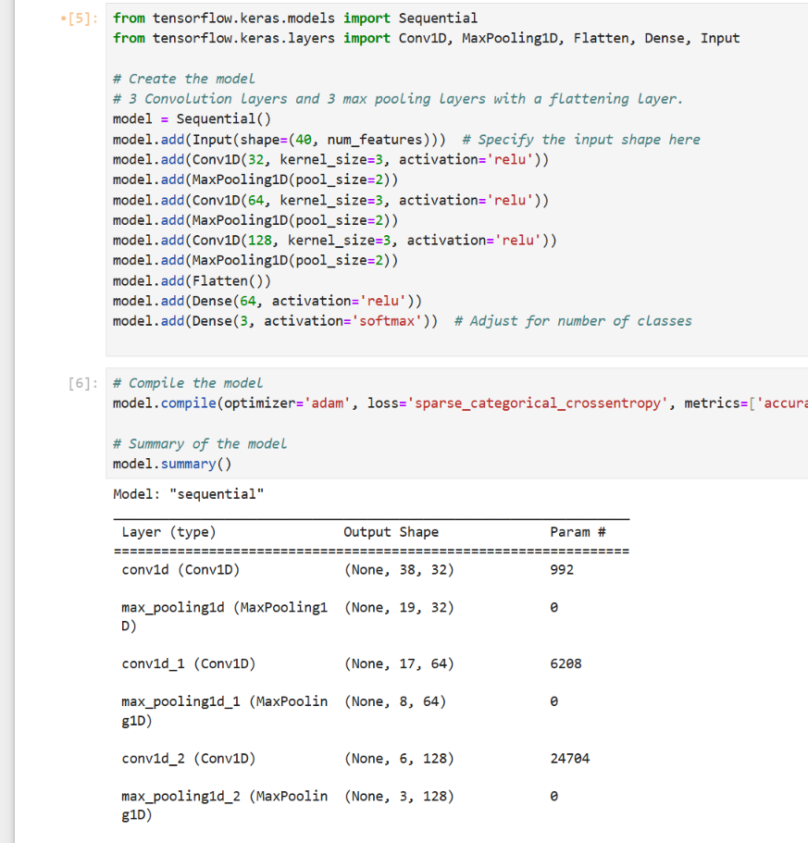
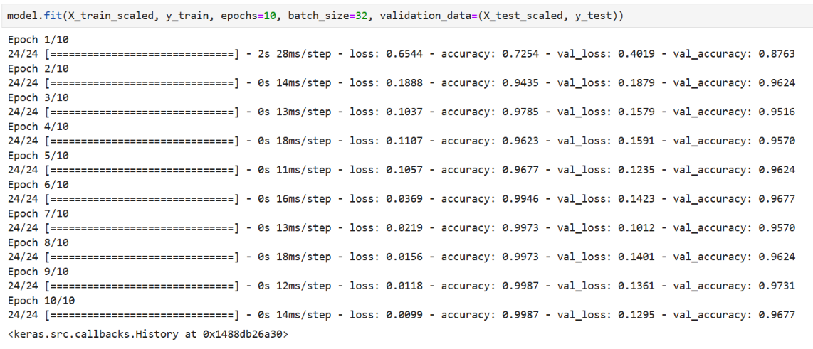
CNN Model
Structure: The model takes 40 frames each with 10 data points.
Layers: 3 Convolutional layers, and 3 max pooling layers.
Test Accuracy: ~ 96.77%

Slide 11
Running Model
The demo runs the model every 40 frames.
It takes about 1.4 seconds to capture 40 frames. (Negligible time process the data)
Final implementation will fill the first 40 frames and run the model prediction every 10* frames. (* - true value to be determined)
We hope that running the prediction model every 10 frames will prevent gestures from being captured between two 40 frame snippets.

Slide 12
Looking Forward
Optimize the model to obtain accuracy closer to 99% percent accuracy.
Improving CNN implementation
Increasing the size of training data.
Add a new gesture for holding & releasing left-click
First use will signal a hold
Second use will signal release
Combined subsystem implementation
Assure the radar package works as intended
Test virtual mouse in common tasks

Slide 13
Gesture Positioning
Daniel Lu
Accomplishments since the last presentation <21> hrs | Ongoing progress/problems and plans until the next presentation
Generate a moving path for the mouse <13> Using different approaches to the output moving path of the mouse to create two point cloud modeling demo code for positioning <3.5> Sponsor Meetings <3.5> Cooperate with Chirp Config demo to generate the output data <1> Generate sample data to test the result | Progress: Validation plans, path validation and error validation, are passed with high accuracy. Problems: The accuracy of output velocity or the moving path of the mouse needs to be considered to add environmental noise. The user is designed to move their hands in parallel from the x-y plane of the radar.

Slide 14
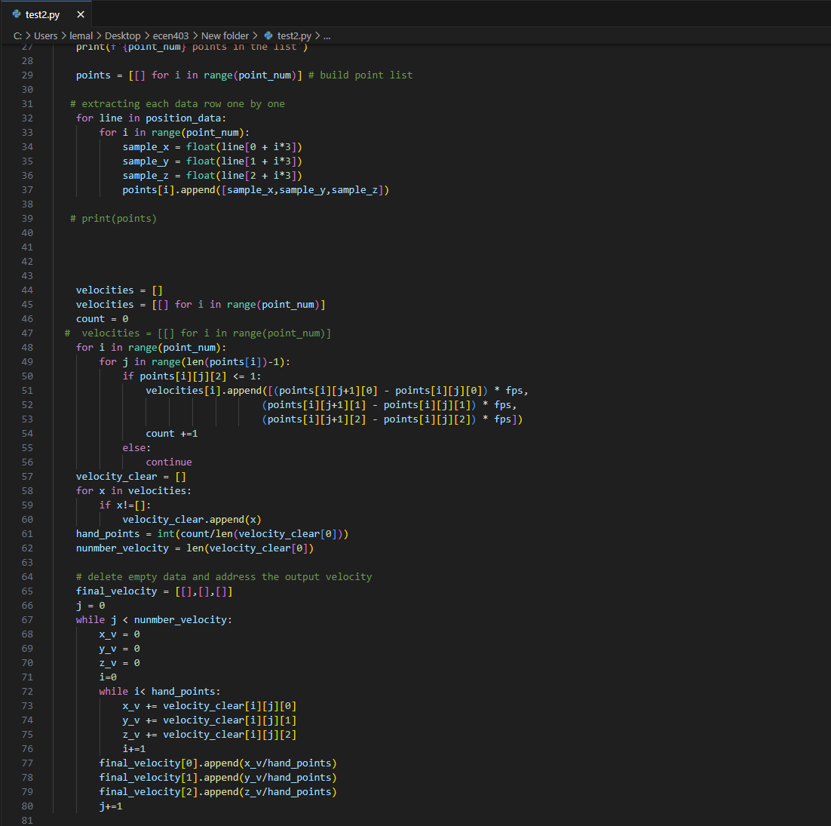
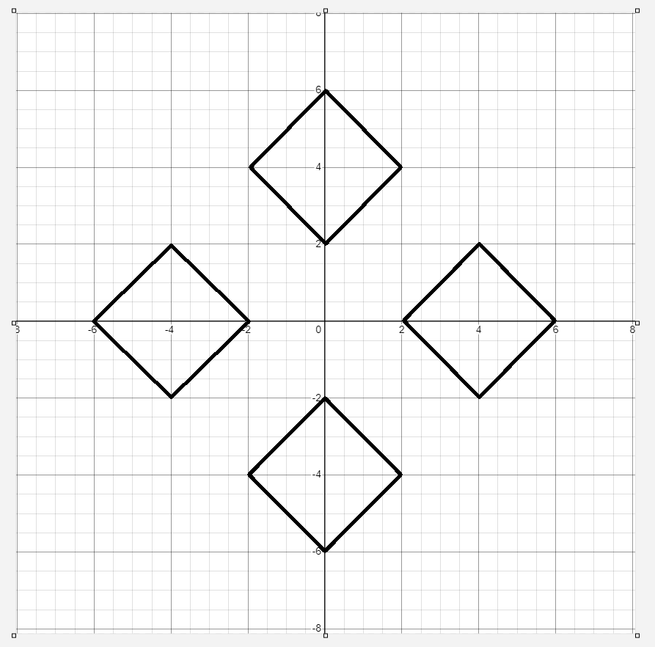
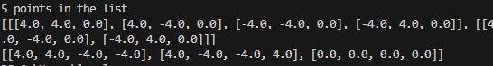
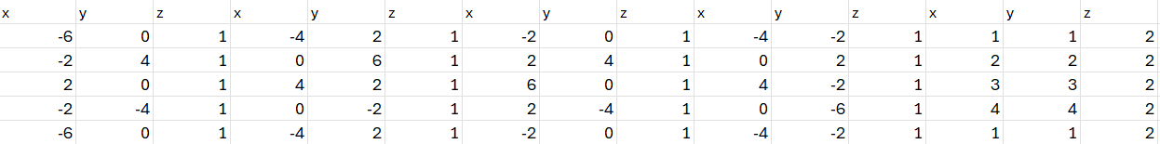

Slide 15
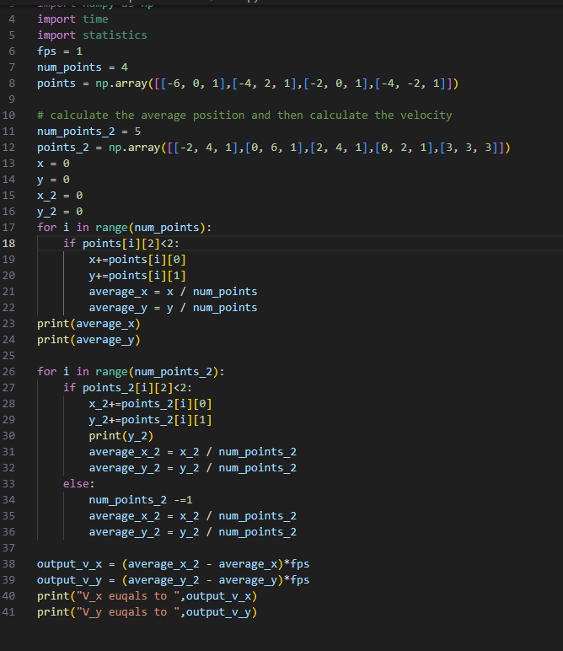
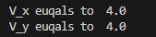

Slide 16
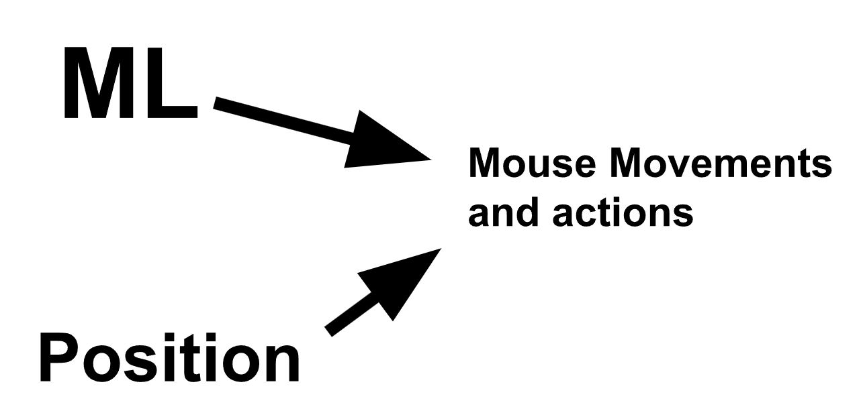
Input Mapping Subsystem
Input Mapping:
Take direction vector from mouse positioning subsystem and convert that to mouse movements
Take the gestures recognized by the Gesture Recognition Subsection and converts that into a mouse action such as right click and left click,.

Slide 17
Input Mapping
Zane Meikle
Accomplishments since the last presentation <20> hours | Ongoing progress/problems and plans until the next presentation
<7> Writing and implementing code to test function <2> meetings with sponsor <4> Generating test data <6> Implementing error handling <1> Helping train Gesture Recognition model | Problems: Python sometimes runs too slow before the next frame, so I have it just skip the next frame. May not be an issue in the final implementation due to how the test program is set up but we will see if it’s an issue in 404. Ongoing Progress: Getting ready for demo and working on final report.

Slide 18
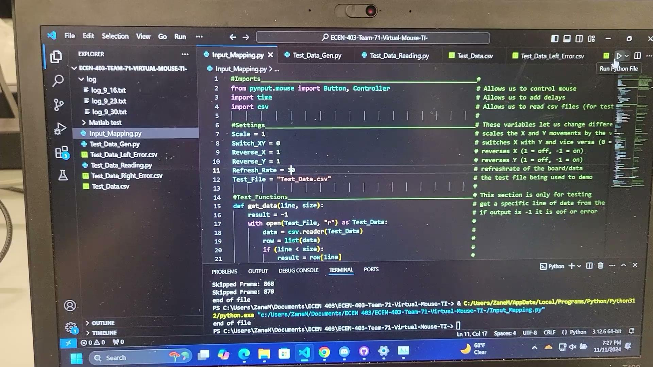
Mouse Movements and Actions

Slide 19
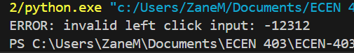
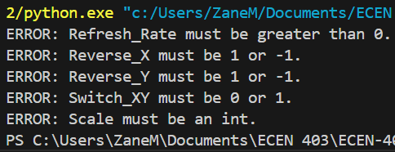
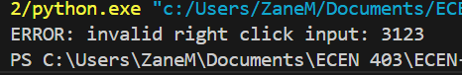
Error Handling Outputs
Invalid Left Click:
Invalid Settings:
Invalid Right Click:

Slide 20
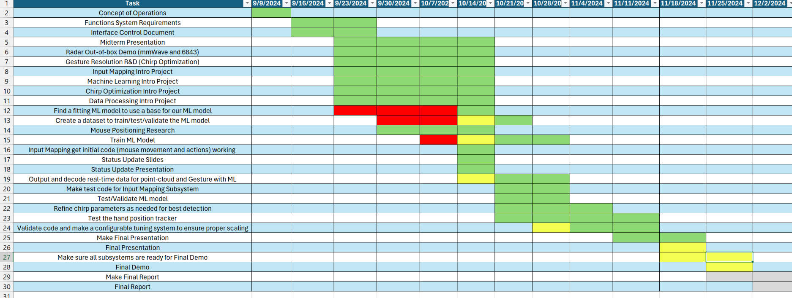
Execution Plan Gantt Chart

Slide 21
Validation Plan
Section | Task | Specification | Result | Owner
3.2.1.6 | Mouse Movement | Mouse can be moved to all corners of the screen by the program. | Passed | Zane
3.2.1.6 | Mouse Actions | The program must be able to right click and left click. | Passed | Zane
3.2.5.2 | Mouse Input Error Handling | The program must properly handle all invalid inputs. | Passed | Zane
3.2.1.4 3.2.1.6 | Gesture positioning | The coordinates of the gesture should be calculated when deleting the error points. | Passed | Daniel
3.2.1.6 3.2.1.8 3.2.3.2.1 | Velocity accuracy | The output velocity of the moving gesture should not have errors. | Passed | Daniel
3.2.1.5 | Hand Gesture Recognition | ML model can recognize the users hand gestures |  | Oscar

Slide 22
Validation Plan
Section | Task | Specification | Result | Owner
3.2.1.5 | Gesture Recognition Accuracy | ML model can correctly identify and categorize hand gestures at least 90% of the time. |  | Oscar
3.2.1.7 | Functional Radar System | The IWR6843AOPEVMs, and MMWAVEICBOOSTs all properly communicate with the computer and transmit data. | Passed | Greyson
3.2.1.8 | Data Decoding | The python script accurately decodes the TLV data seen from both radars. | Passed | Greyson
3.2.1.3 3.2.1.4 | Radar Angle and Distance | The radars can capture gestures and pointer positions within a 90 degree range up to 1.5 feet | Passed | Greyson
3.2.1.5 | Hand Size | Radar will recognize gestures regardless of hand size. |  | Oscar

